Slide 1
STR
A Simple and Efficient Algorithm
for R-Tree Packing
Scott T. Leutenegger, Mario A. Lopez, Jeffrey Edgington
Sunho Cho
Jeonghun Ahn

Slide 2
Overview
R Tree Packing
Packing Algorithm
  Nearest –X
  Hilbert Sort
  Sort –Tile Recursive
Experimental Methodology Results
  Synthetic
  GIS
  VLSI
  CFD
Conclusions

Slide 3
Packing
R-Tree are dynamic structure : their contents can be modified without reconstructing the entire tree
Disadvantages of inserting one element at a time into a R-Tree :
  High load time
  Suboptimal space utilization
  Poor R-Tree structure
Preprocessing advantageous for static data
Nearly 100% space utilization and improved query times

Slide 4

Basic Algorithm
1. Preprocess the data file so that the r rectangles are ordered in [r/b] consecutive groups of b rectangles, where each group of b is intended to be placed in the same leaf level node.
2. Load the [r/b] groups of rectangles into pages and output the (MBR, page-number) for each leaf level page into a temporary file.
3. Recursively pack these MBRs into nodes at the next level, proceeding upwards, until the root node is created.

Slide 5
R-Tree Packing Algorithms
Nearest X (NX)
Hilbert Sort (HS)
Sort-Tile-Recursive (STR)
Three algorithms differ only in
how the rectangles are ordered
at each level

Slide 6
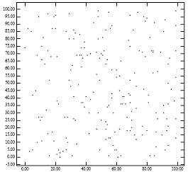
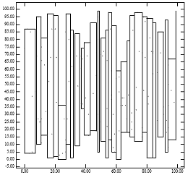
Nearest-X
Rectangles are sorted by x-coordinate (center of the rectangle)
Rectangles are then ordered into groups of size b.

Slide 7
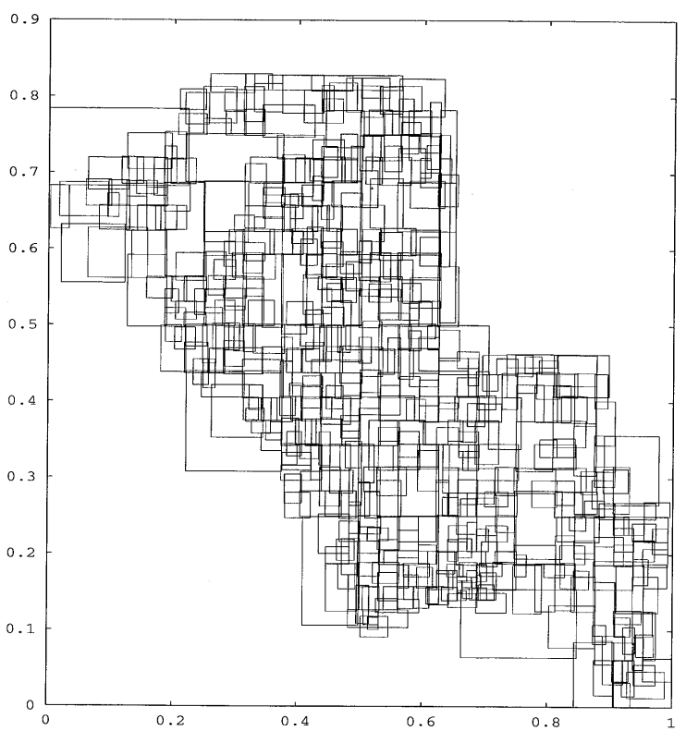
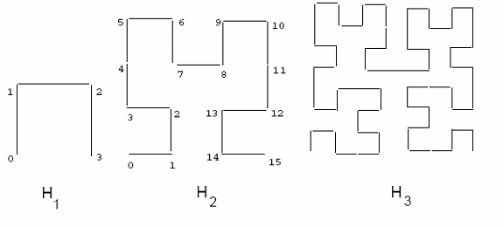
Hilbert Sort
Rectangles are ordered by using the Hilbert space filling curve
  (center point of the rectangles are sorted based on their distance from the origin, measured along the Hilbert Curve)

Slide 8
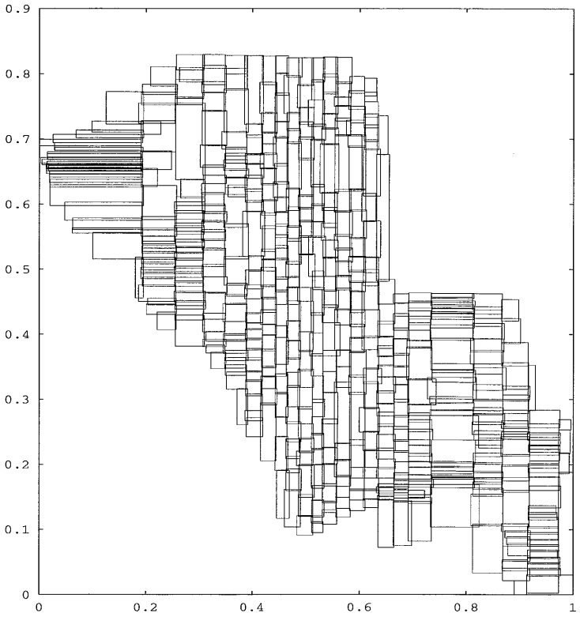

Sort-Tile-Recursive
Sort the rectangles by x-coordinate and partition them into S vertical slices.
A slice consists of a run of S×b rectangles.
Sort the rectangles of each slice by y-coordinate.
Pack them into nodes by grouping them in size of b.
Notes:
P = [r/b]

Slide 9
Classes of Data
Synthetic
  Uniformly distributed point and region data
Geographic Information System
  Mildly skewed line segment data
VLSI
  Highly Skewed in location and size region data
Computational Fluid Dynamics
  Highly skewed, in terms of location, point data
Notes:
For a buffer of size 10, HS requires 31 - 42% more disk accesses than STR for point data, and 26 - 32% more disk access for region data of
density 5. For a buffer of size 250, HS requires 33 -41% more disk access than STR for point data, and 26 - 32% more disk access for region data of density 5.
Note that as query region size increases, the difference between STR and HS becomes smaller (but STR always requires fewer disk accesses). This result is not surprising since the more data that needs to be retrieved the more naive the search algorithm can afford to be [3]. Carrying this argument to an extreme, if the query regions encloses all input data then no search needs to be performed: all

Slide 10
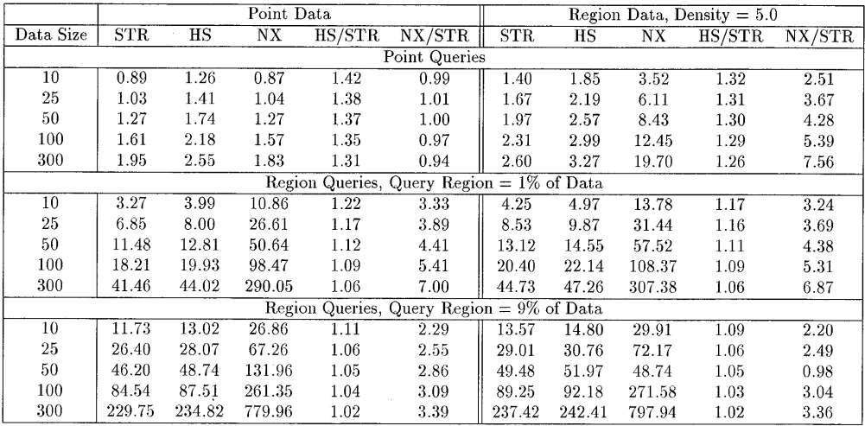
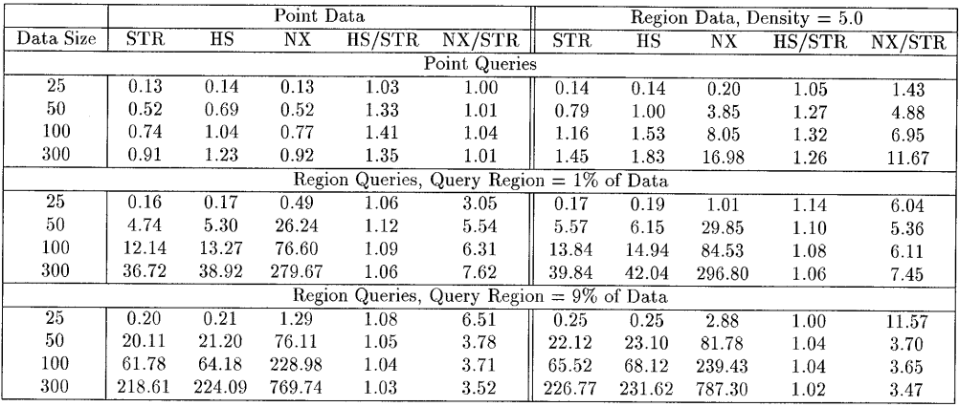
Synthetic Data - Uniformly Distributed Data
Hilbert sort 42% more disk accesses than STR for both point and range query.
NX algorithm performs well as well as STR for point queries

Slide 11
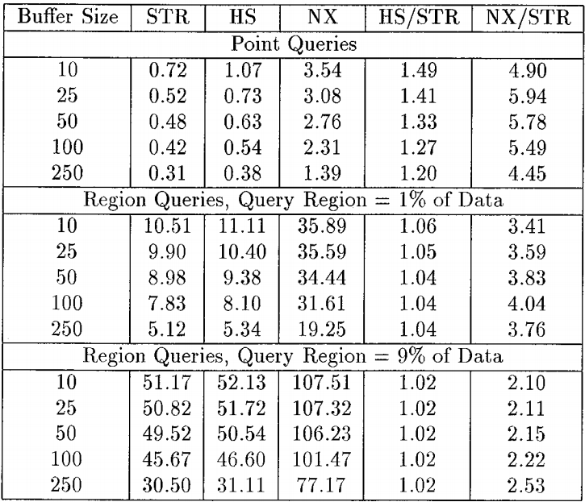
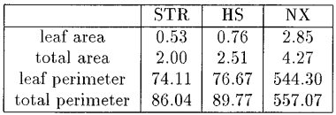
GIS tiger data - Mildly skewed Data
HS algorithm requires up to 49% more disk accesses than STR for both point and region queries.
As region size increases, the difference between STR and HS becomes smaller.
Number of disk accesses as a function
of query and buffer sizes
areas and perimeters

Slide 12
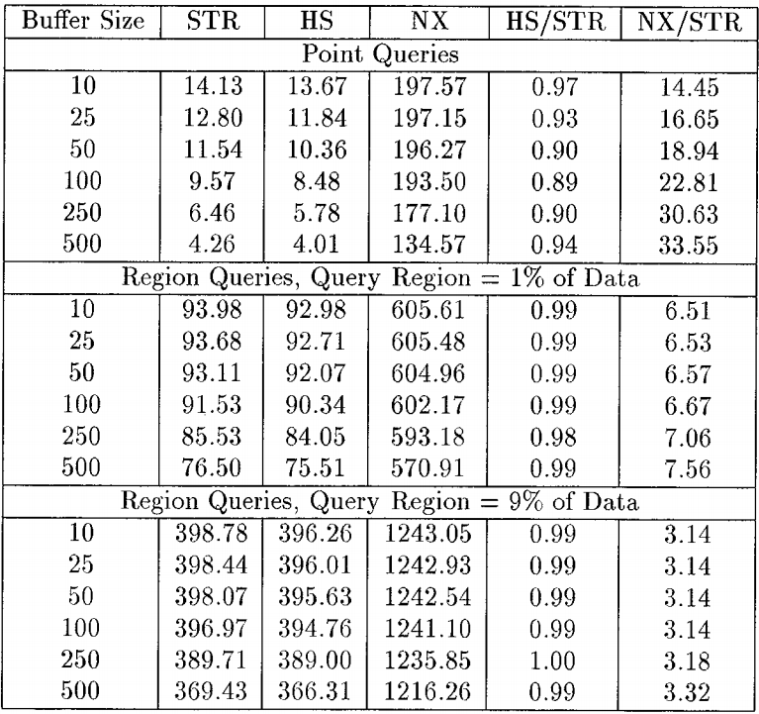
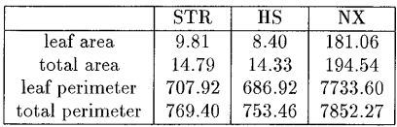
VLSI - Highly Skewed Data
Number of disk accesses as a function
of query and buffer sizes
areas and perimeters
For region data, HS performed 3% - 11% faster than STR for point queries and roughly the same for region queries.

Slide 13
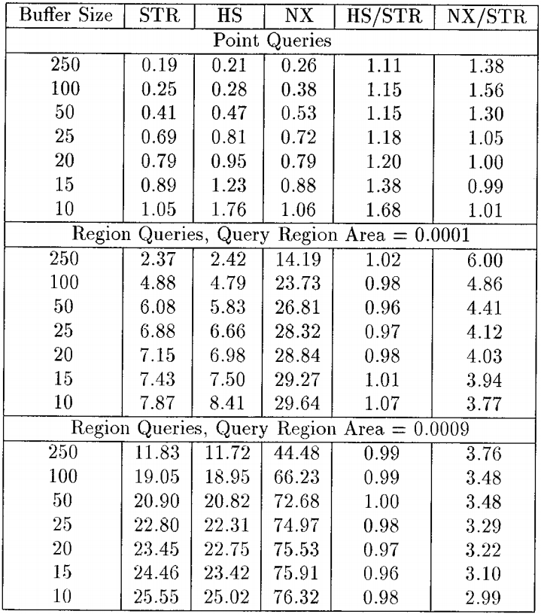
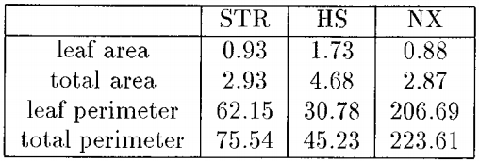
CFD - Highly Skewed Data
For point data, HS required 11- 68% more disk access than STR for point queries, and roughly the same for region queries.
CFD dafa (52,510 nodes)
disk accesses as a function of query and buffer sizes
CFD Data (51,510 nodes)
areas and perimeters

Slide 14
Conclusions
All algorithms based on heuristics
None of them is best for all datasets
NX is not competitive
Decision of using HS or STR is dependent on the type of the dataset
Importance of choosing a packing algorithm is diminished as either the query size or the buffer size increase

